Slide 1

Exception handling
Lecturer
Rokas Slaboševičius
Data

Slide 2
Today you will learn
Exception handling
What is exception handling?
01
Why do we need exception handling?
02
What are the types of exceptions?
03

Slide 3
What is exception handling?
Exception handling
In computing and computer programming, exception handling is the process of responding to the occurrence of exceptions - anomalous or exceptional conditions requiring special processing - during the execution of a program. In general, an exception breaks the normal flow of execution and executes a pre-registered exception handler; the details of how this is done depend on whether it is a hardware or software exception and how the software exception is implemented.
https://en.wikipedia.org/wiki/Exception_handling

Slide 4
Exception handling keywords
Exception handling
Try - A code blog where you are expected to get a particular bug
Catch - A block of code that is run when an error is caught in the Try block
Finally - A block of code that is allowed at the end of a try/catch, whether or not the error was caught. E.g.: In the try block, we opened a file and need to close it whether an error occurred or not.

Slide 5
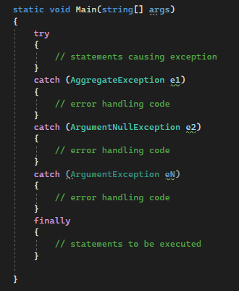
Syntax
Exception handling

Slide 6
Types of errors
Exception handling
Exceptions are defined as classes. The Exceptions class inherits directly or indirectly from the System.Exception class. Some of these are the System.ApplicationException and System.SystemException classes.
The System.ApplicationException class supports errors generated by the application, so exception classes created by the developer should inherit from this class.
System.SystemException is the parent class for all existing exception classes.

Slide 7
Types of errors
Exception handling
No. | Exception class and description
1 | System.IO.IOException: handles errors related to input and output (input/output)
2 | System.IndexOutOfRangeException: handles errors generated when a method tries to access an element in an array with an index too large for the array size.
3 | System.ArrayTypeMismatchException: handles errors generated when an attempt is made to insert an element into an array whose data type is incorrect.
4 | System.NullReferenceException: handles errors generated when a program tries to access a null element.
5 | System.DivideByZeroException: handles errors when the program tries to divide by zero.
6 | System.InvalidCastException: handles errors generated by a bad cast.
7 | System.OutOfMemoryException: handles errors generated in case of memory failure.
8 | System.StackOverflowException: handles errors when the stack is full

Slide 8
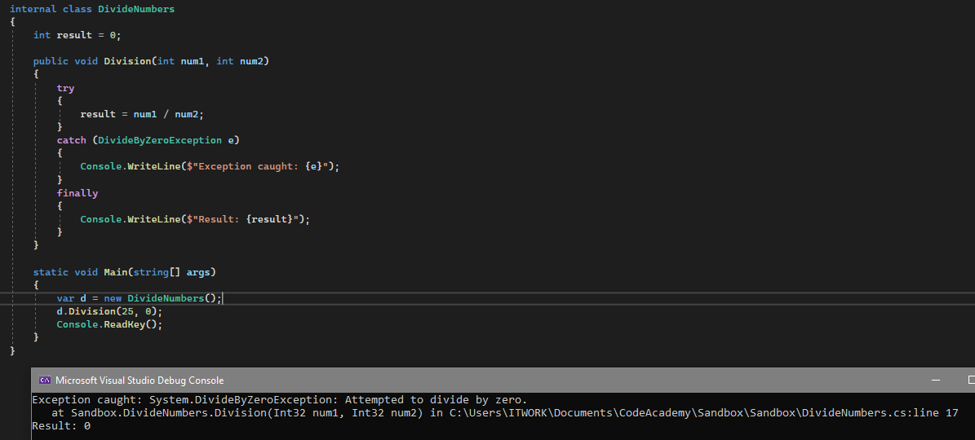
Error handling
Exception handling
Here we see a program that has a method Division with parameters int num1 and int num2 that it tries to divide and if it is caught trying to divide by zero then it goes to the catch(DivideByZeroException e) block and prints an error, then goes to finally and prints the result

Slide 9
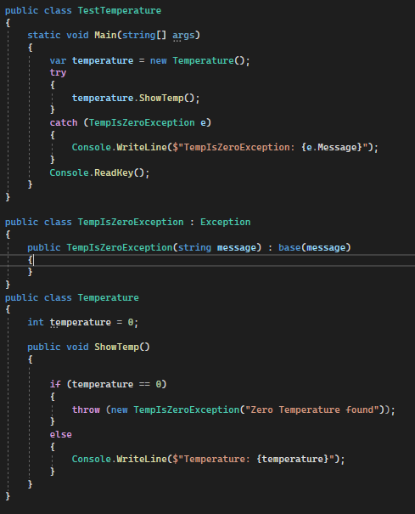
Creating your own exceptions
Exception handling
Here we see a class called TempIsZeroException which inherits from the Exception class. The other class is Temperature, which has an if clause that says if the temperature reaches 0 degrees our TempIsZeroException error is thrown.

Slide 10

Exception handling
Task 1
Check the System.Convert.ToDouble documentation, what errors can occur when converting string to double?
Write a program that will catch these errors and print to the console what the error was.

Slide 11
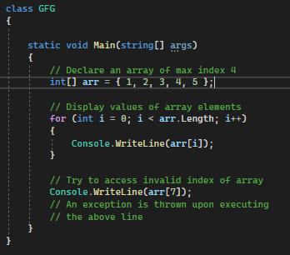
Exception handling
Task 2
Fix this code with the try/catch mechanism:

Slide 12
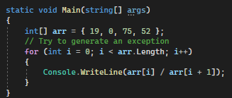
Exception handling
Task 3
Anticipate possible errors in the code and print out the errors with try/catch:

Slide 13
Exception handling
Task 4
Create a file reading class.
What errors can occur when trying to read a file?
Trying to find a file?
Create mechanisms to protect against "breaking the programme"

Slide 14
Exception handling
Exception handling
https://www.tutorialspoint.com/csharp/csharp_exception_handling.htm https://www.tutorialsteacher.com/csharp/csharp-exception-handling
Useful information

